Slide 1
COLLEGE MANAGEMENT SYSTEM
Project Done By
C.Jeevitha
S.Shanmugapriya

Slide 2
Tools Required
Front-End : Angular
Back-End: SpringBoot

Slide 3
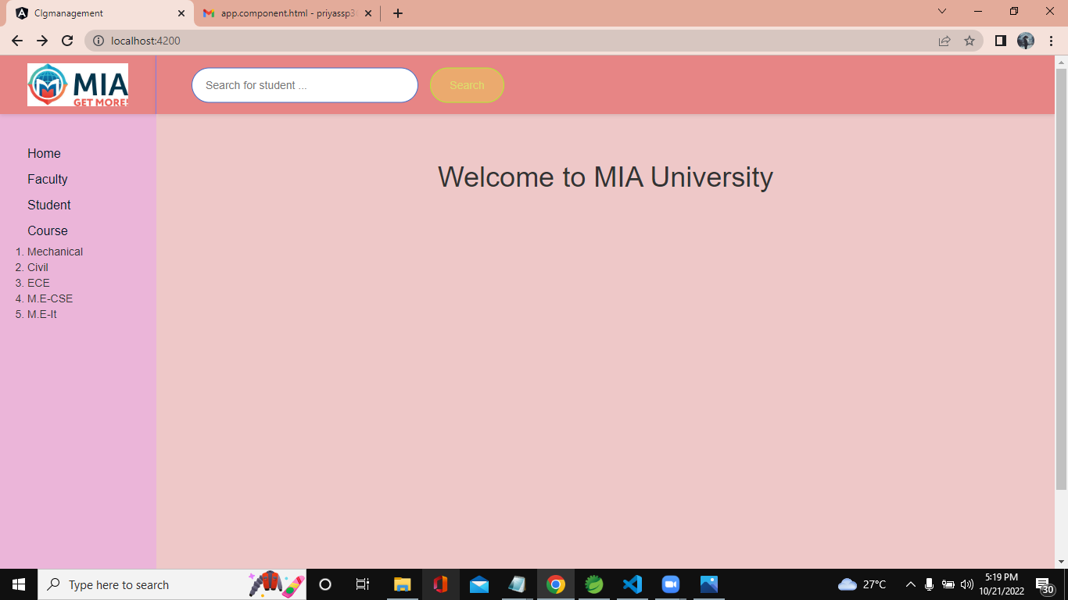
WELCOME PAGE

Slide 4
CRUD OPERATIONS: 1.CREATE(Add Student Data)

Slide 5
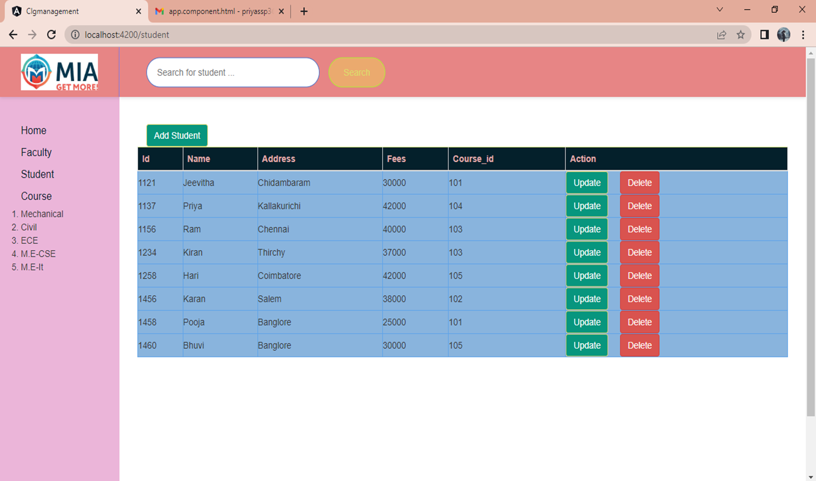
Before Add Student(Student List)

Slide 6
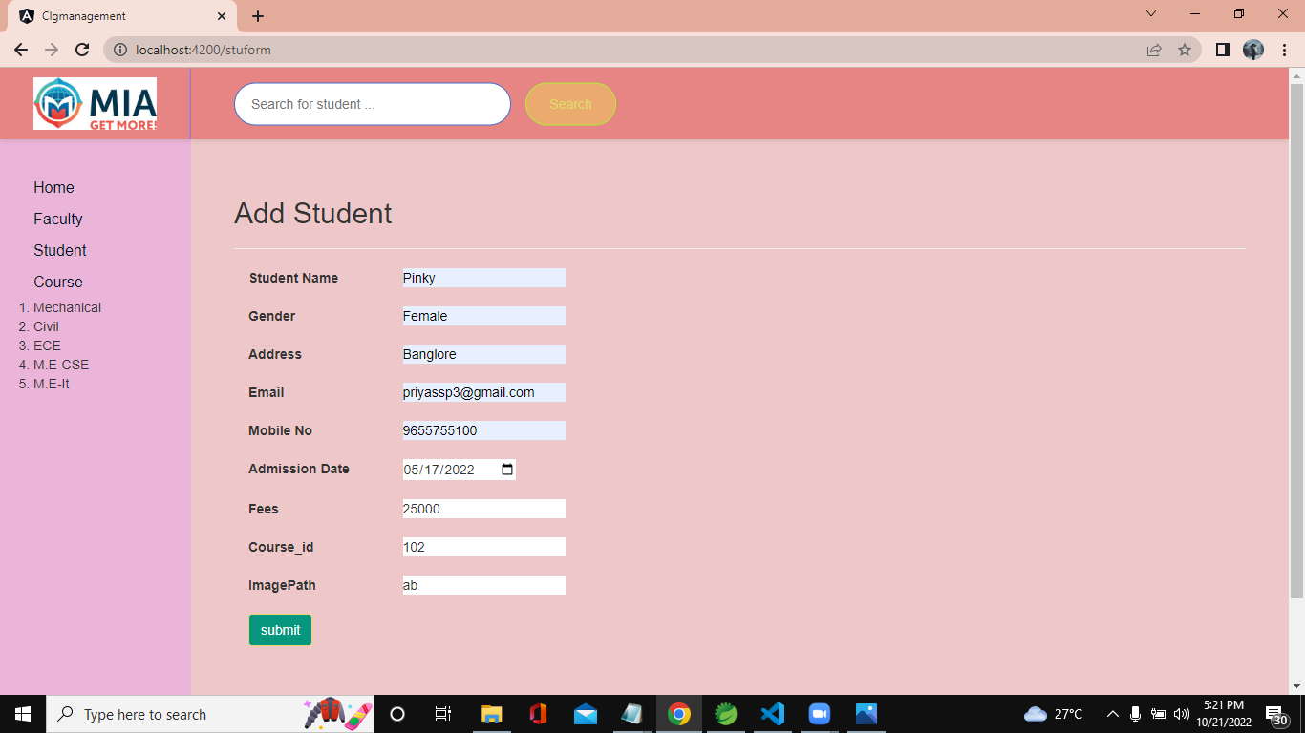
Add Student (Form)

Slide 7
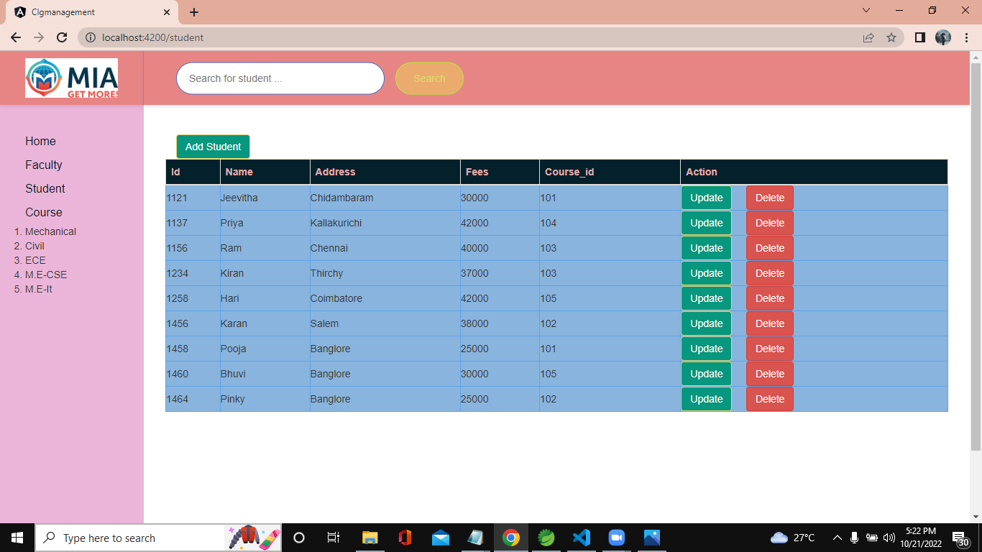
After Add Student (Pinky Data)in Student List

Slide 8
CRUD OPERATIONS : 2.RETRIEVE(View student list)

Slide 9
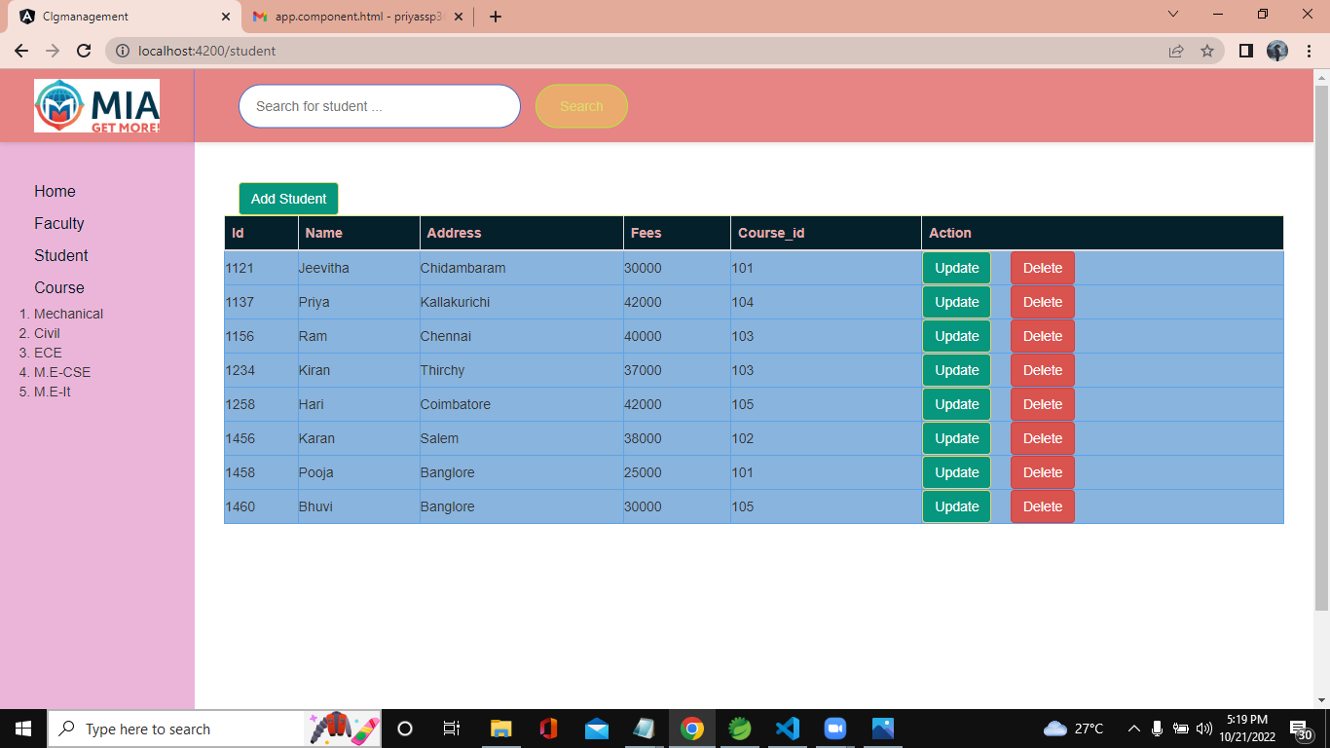
VIEW STUDENT LIST

Slide 10
CRUD OPERATIONS : 3.UPDATE (Update Student through Id)

Slide 11
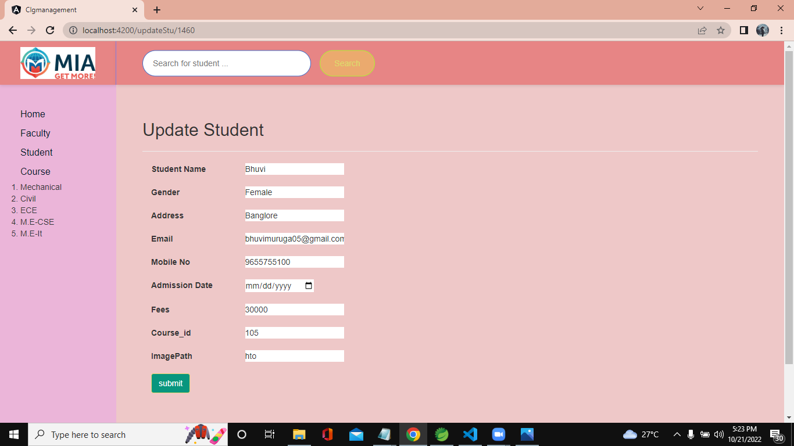
Update Student(Form)

Slide 12
Before Update(Student Data)

Slide 13
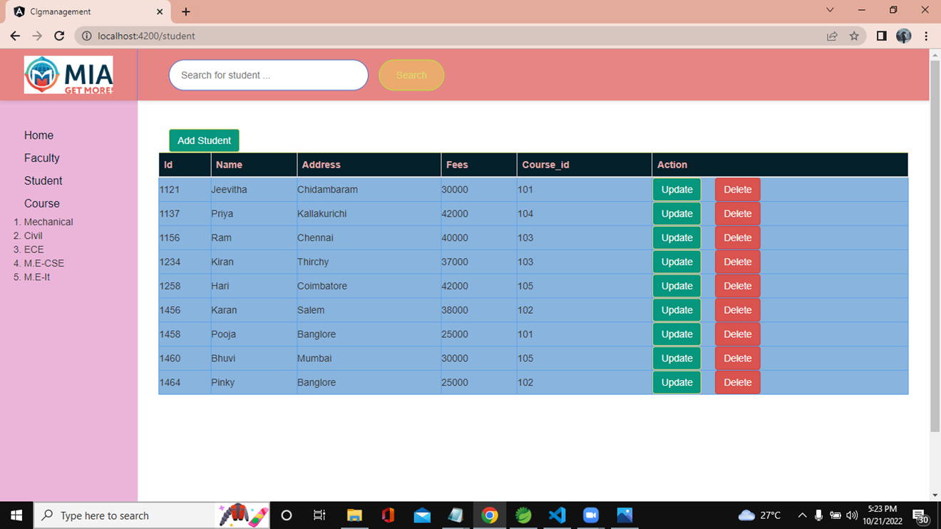
After Update Student(1460 Data) 1460:Banglore->Mumbai

Slide 14
CRUD OPERATIONS 4.DELETE (Delete Student Data)

Slide 15
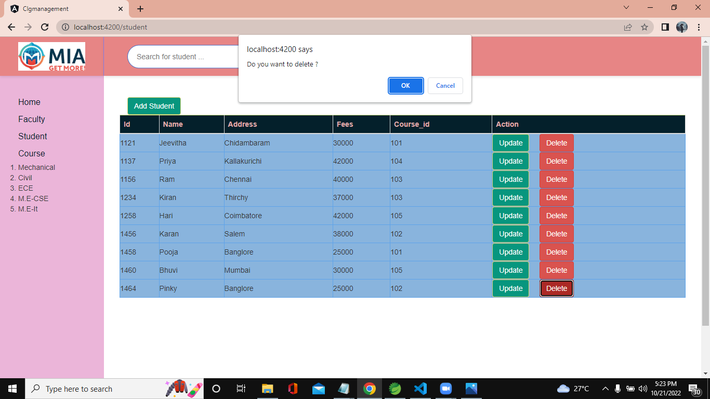
Before Delete Student Data

Slide 16

After Delete (Pinky Data)

Slide 17
SEARCH (Search Student Data through Name)

Slide 18

Search

Slide 19
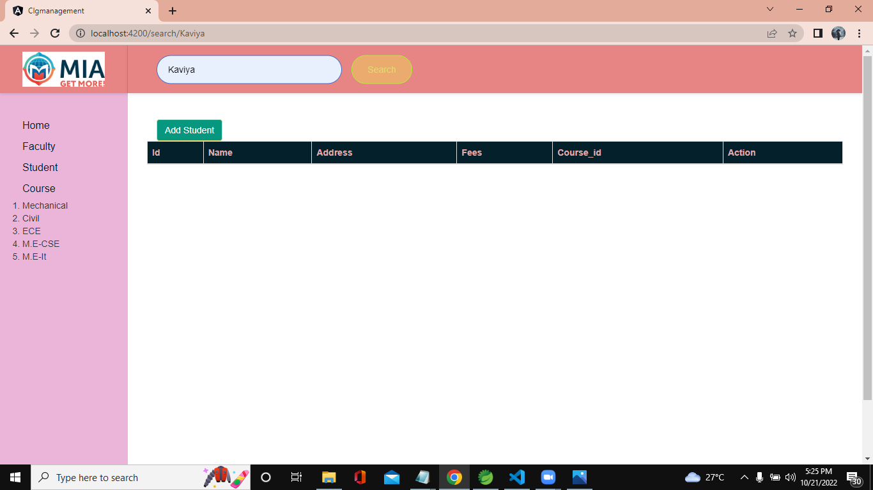
After Search(Kaviya not exist)

Slide 20

Search

Slide 21
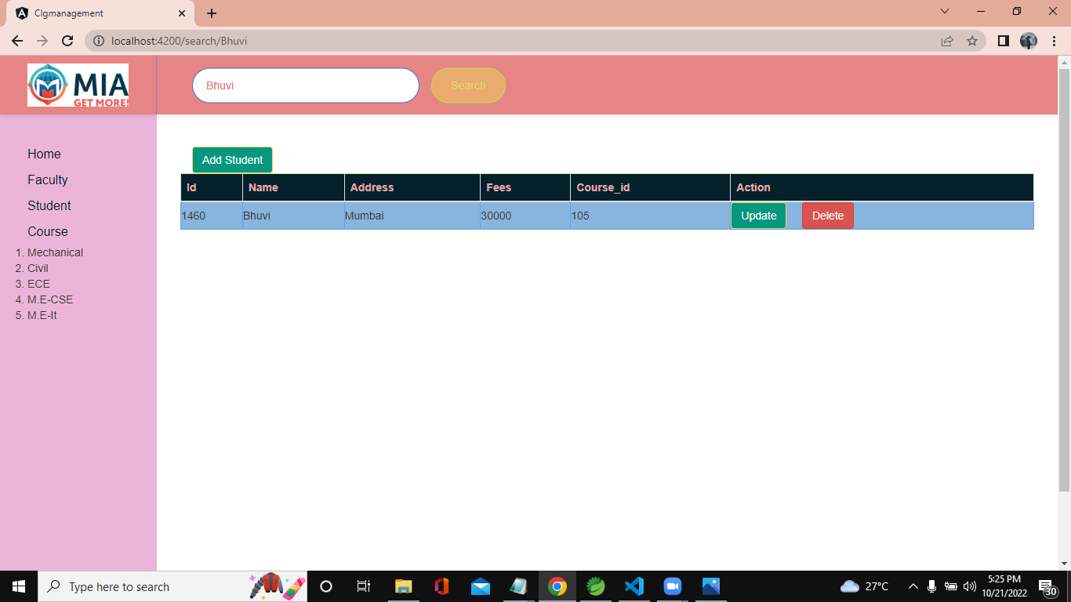
After Search (Bhuvi exist)

Slide 22
Thank You

